Slide 1
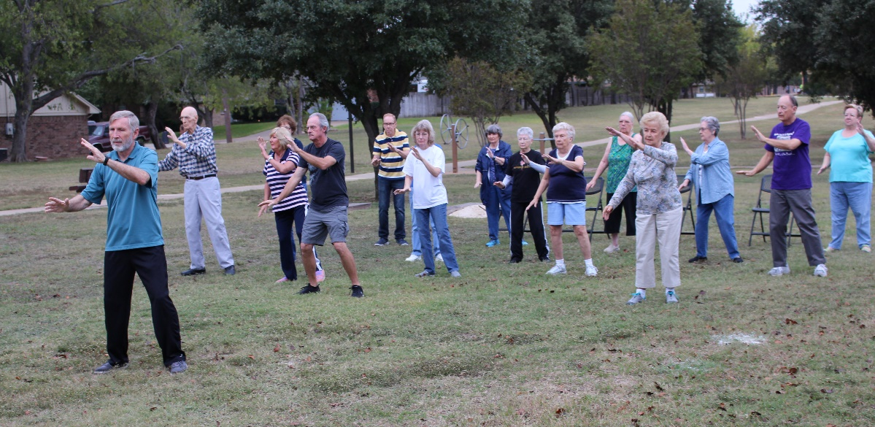
Heard of Tai Chi? Like to try it? Here’s your chance!
Free classes for all ages and abilities starting at 1 pm Saturday 27 February 2016 near the community pool.
Contact certified instructor Ron Smith: smithronc@msn.com
Facebook: T’ai Chi for Your Life

